Slide 1
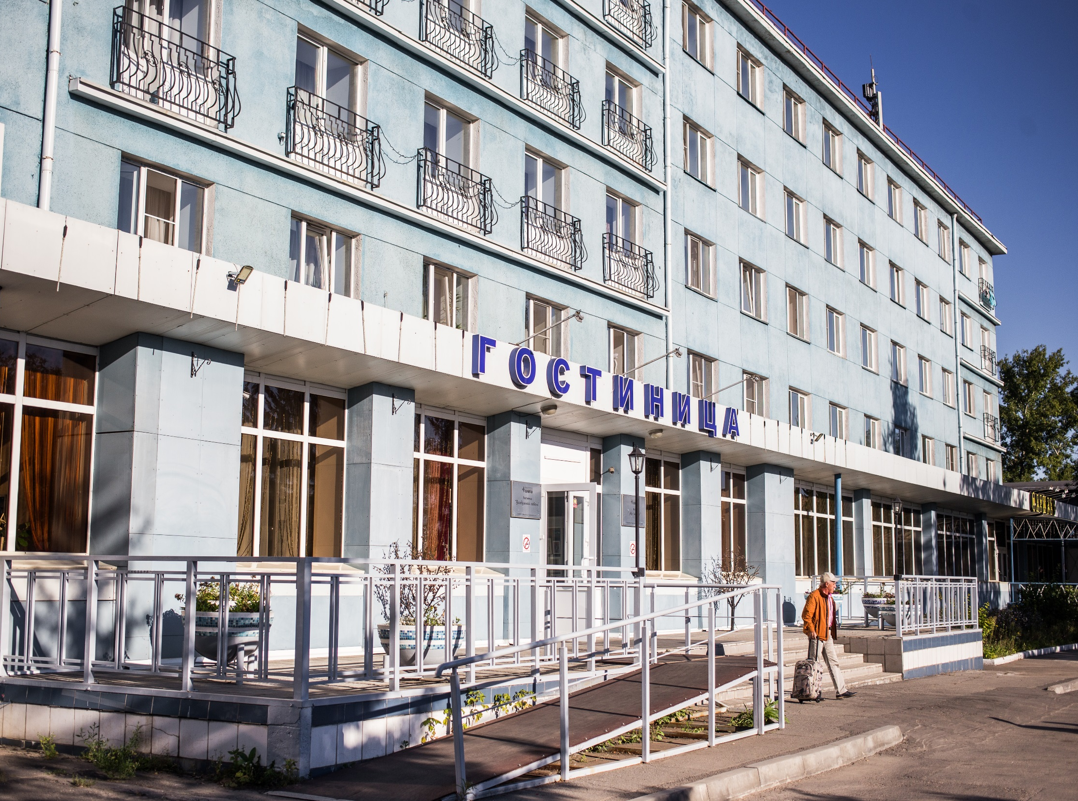
HOTEL “VOZDUSHNAYA GAVAN”

Slide 2
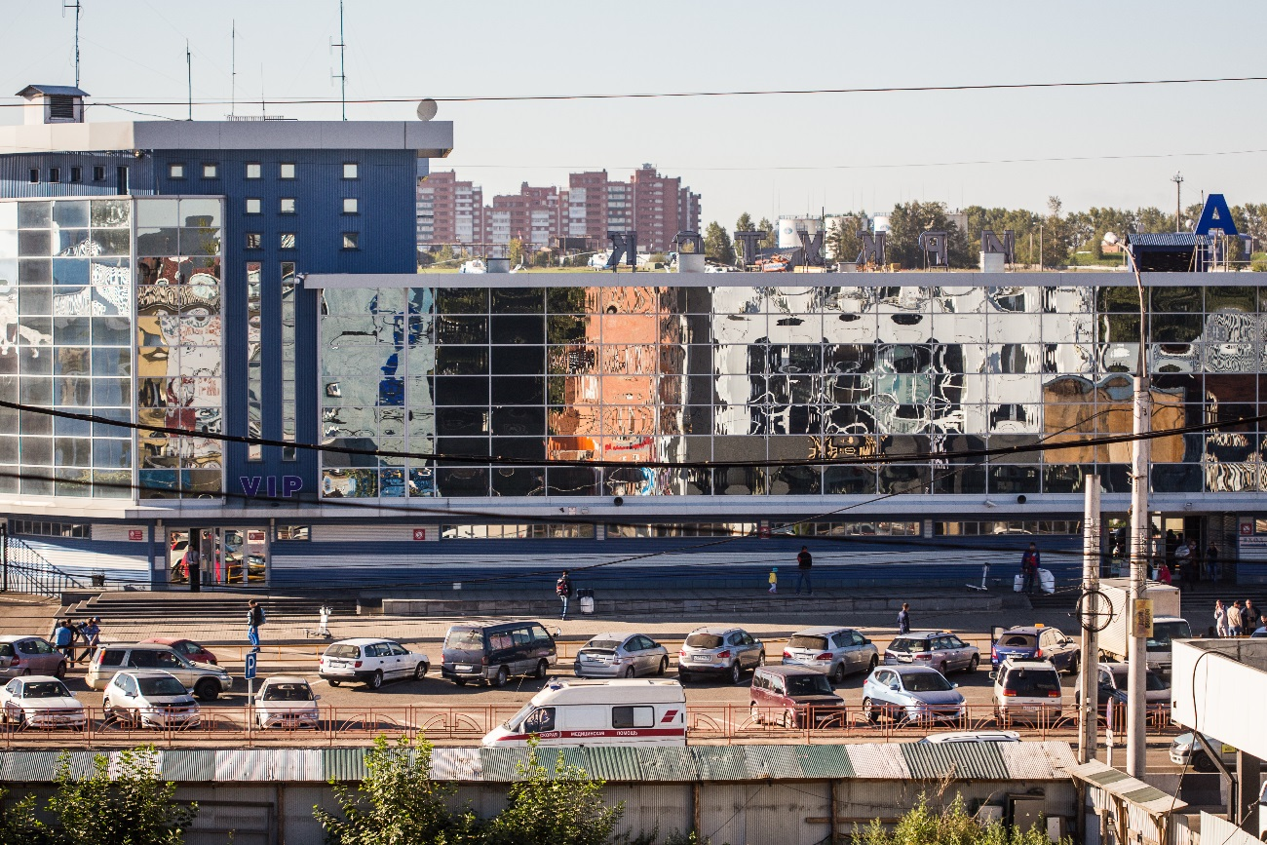

THE NEAREST HOTEL TO THE AIRPORT
The hotel is located on the forecourt of JSC "International Airport Irkutsk", 200 meters from the terminals.

Slide 3
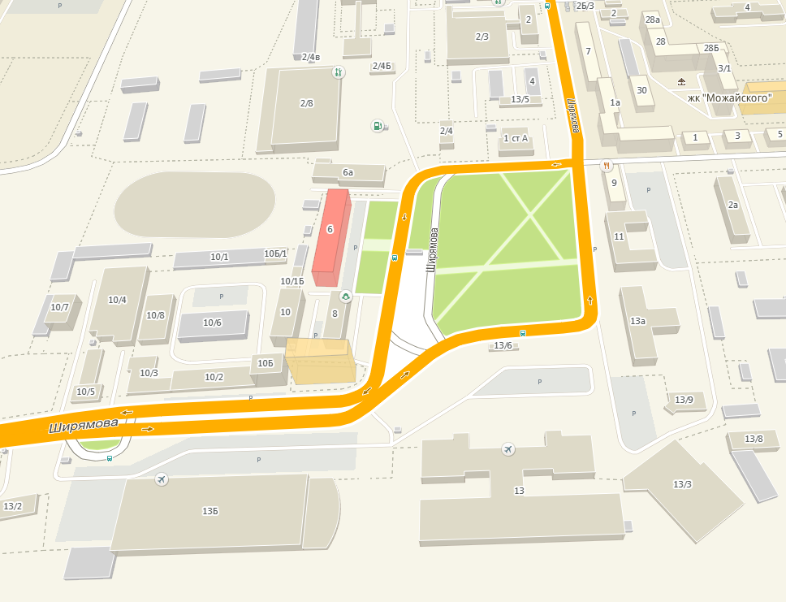
CONVENIENT TRANSPORT INTERSECTION
Hotel “Vozdushnaya Gavan”
Near the hotel, we have convenient transport intersection, you can reach the city center in 20 minutes by bus or taxi.
Bus station
Domestic terminal
International terminal

Slide 4
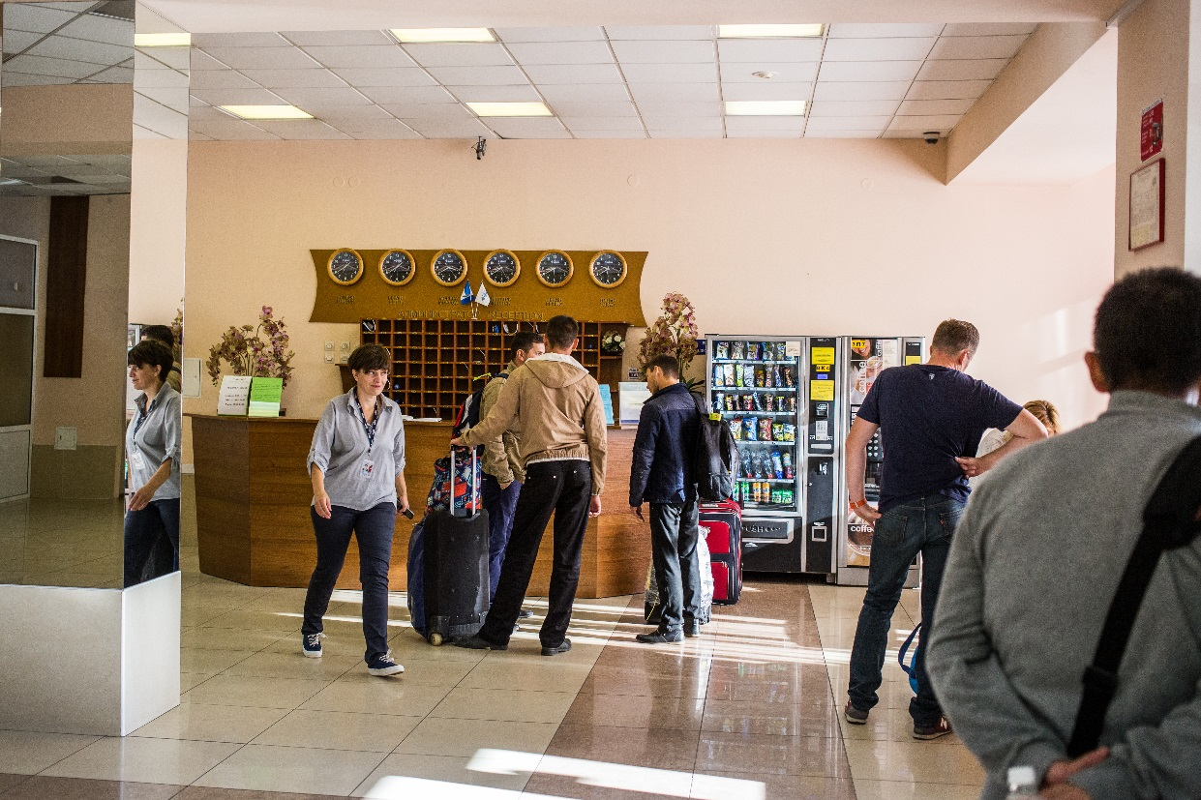
145 COMFORTABLE ROOMS
The hotel includes 145 comfortable rooms and ready to host 233 guests. We offer three categories of rooms: economy, standard, comfort.
All rooms are equipped with new furniture: bed, desk, bedside table, TV, air conditioning, refrigerator, hair dryer, telephone, kitchen utensils. Every room has bathroom equipped with personal hygiene.

Slide 5
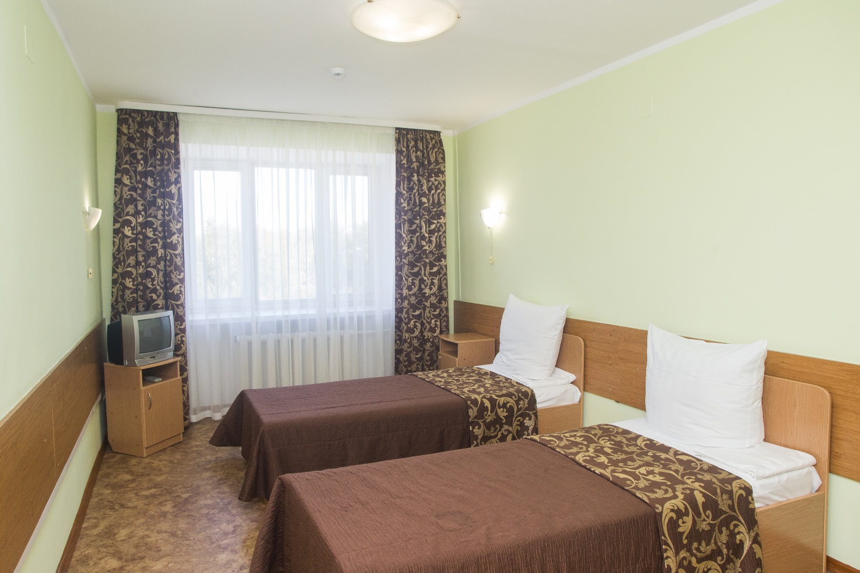
CATEGORY: ECONOMY

Slide 6
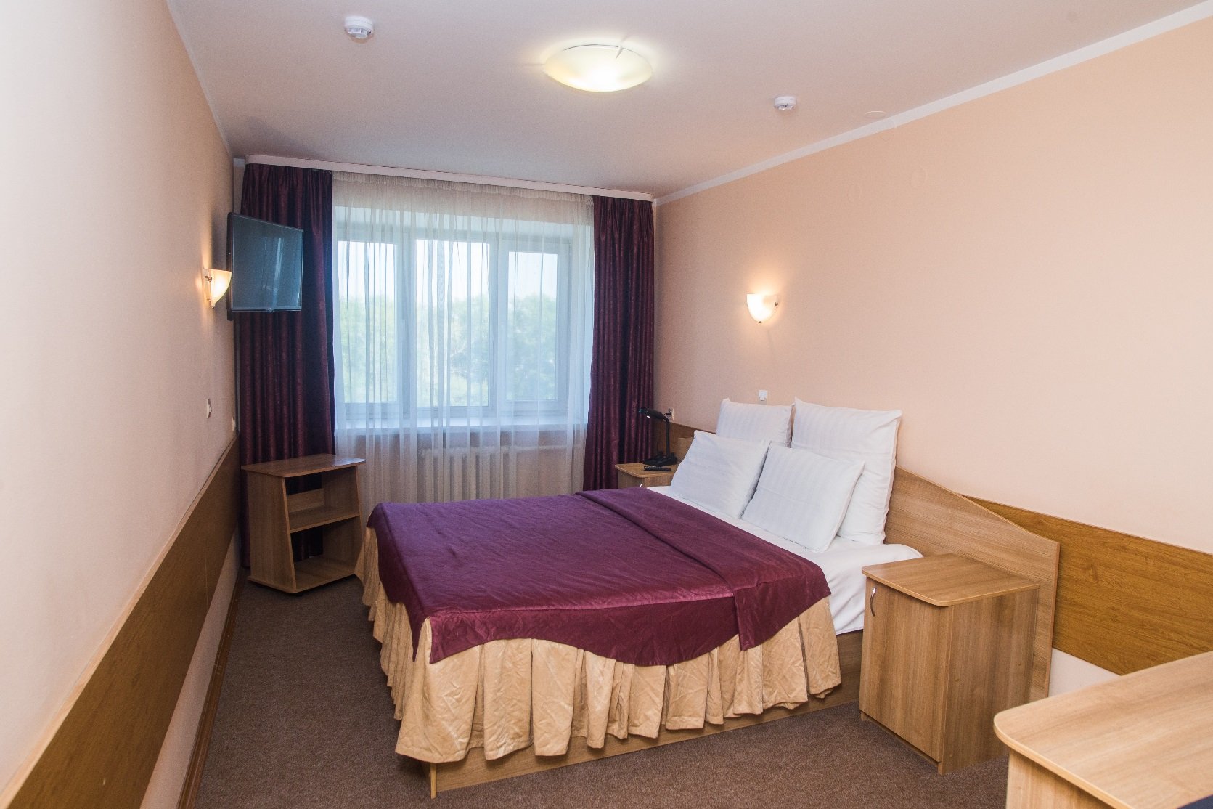
CATEGORY: STANDARD

Slide 7
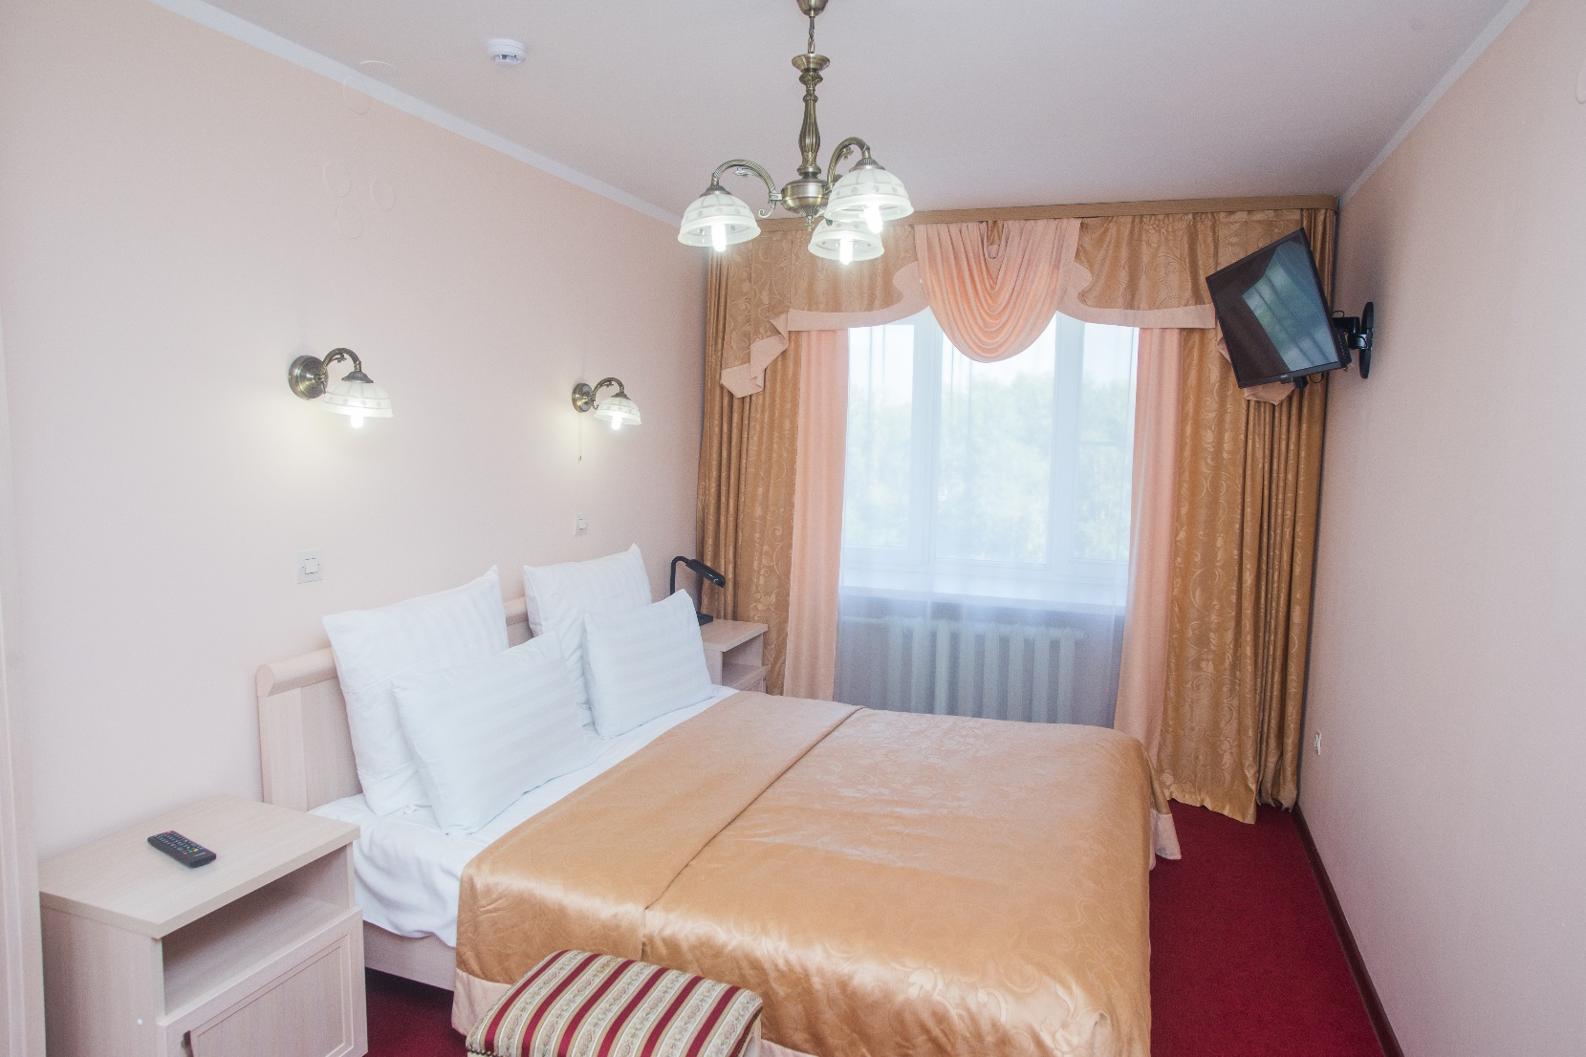
CATEGORY: COMFORT

Slide 8
REASONABLE PRICE –
ONE OF OUR PRIORITIES.
Welcome
Tel: +7 (3952) 26-64-33, 26-61-30
E-mail: bron@iktport.ru

